Slide 1
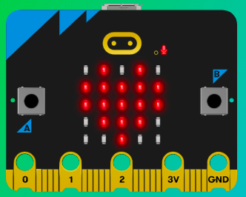
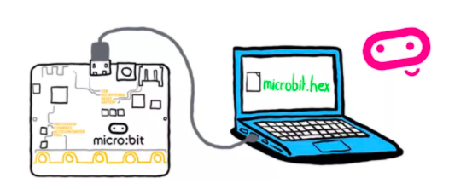
MicroMakers!
KIDS’ MAKER CLUB OF WASHINGTON, DC
Meet Ups #5 and #6

Slide 2
RECAP!
Accelerometer
Variable
Threshold
Saving Battery Power through Code
Notes:
LEDs, Buttons, Light Sensor

Slide 3
RECAP: Accelerometer
If the acceleration is greater than (>) 1500, the steps variable is increased by one and show the step count on the LED display output. 1500 is the threshold – the point at which a movement will trigger a step to be counted.
You may need to change the 1500 number to make the step counter more accurate – but you can decide what threshold to use, whereas with the ‘shake’ gesture the threshold has been decided for you by the people who designed the micro:bit.
Modifying the threshold to work for you is called calibration.
Note that when micro:bit is not moving, the accelerometer gives a strength reading of about 1000. This is caused by the Earth’s gravity pulling down on the micro:bit. (WOW!!)

Slide 4
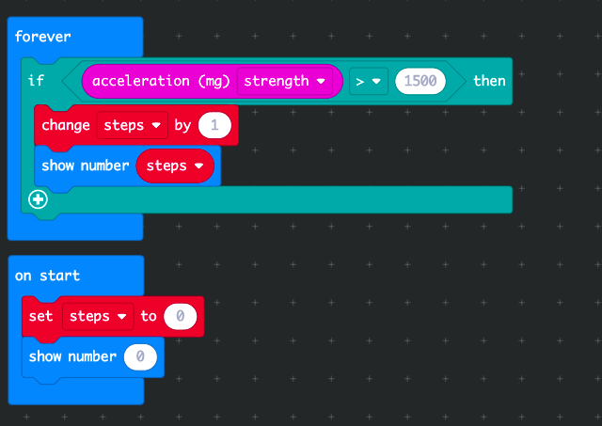
RECAP: Accelerometer

Slide 5
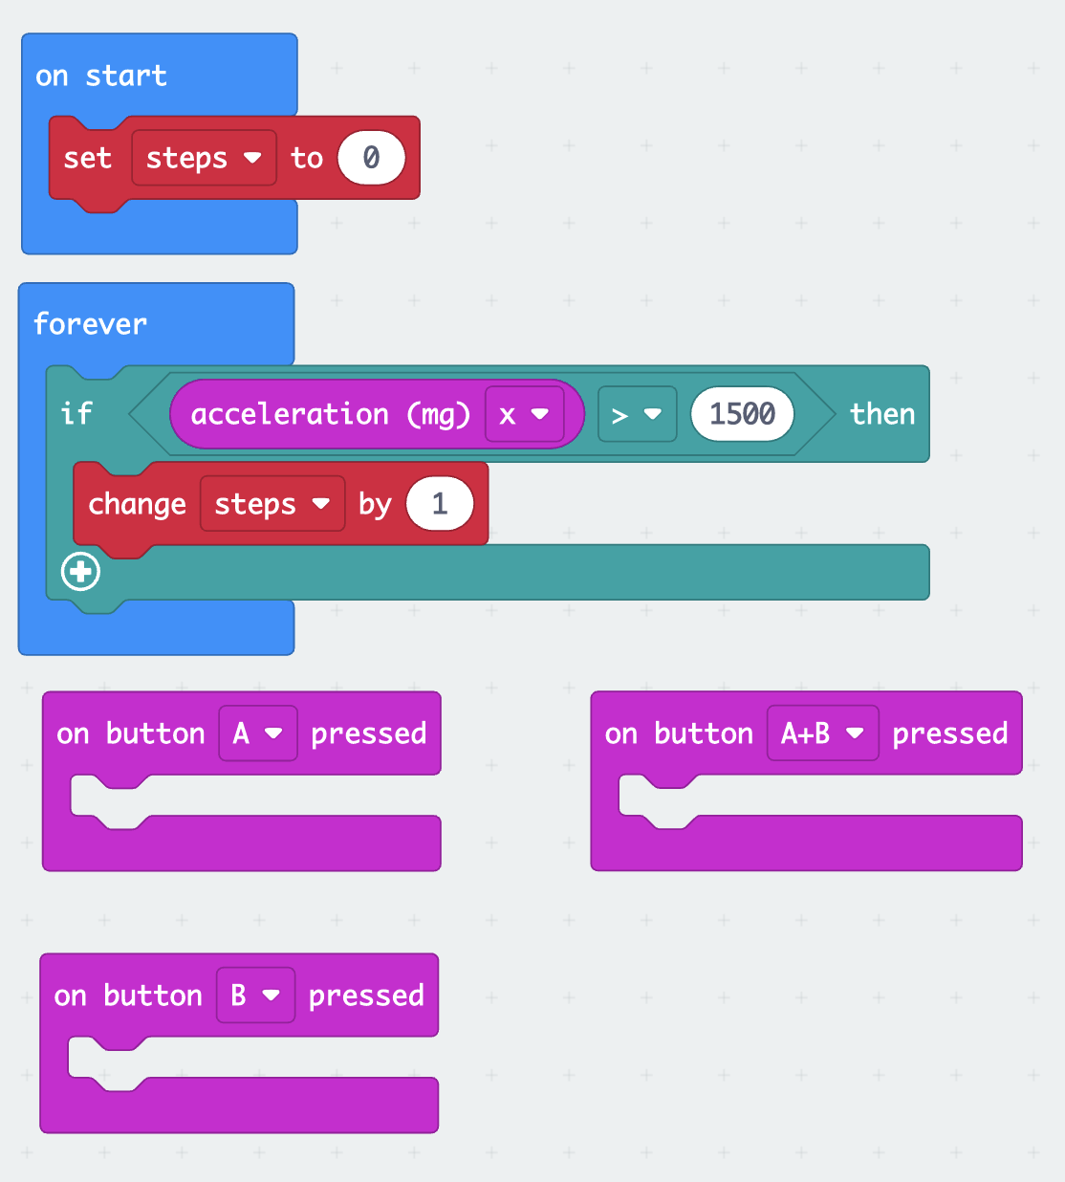

SKILL BADGE
Making a device that measures distance traveled.
YOUR MISSION
Measure the length of your step (with a ruler) and get the micro:bit to multiply this length by the number of steps to calculate the distance you’ve walked (hint: you’ll need the “math” menu).
Show number of steps when you press button A
Reset number of steps to zero when you press button B
Show distance walked when you press buttons A+B together.

Slide 6
Share Your Creation!

Slide 7
PROGRAMMING PRACTICE!
Adding Function Frogs to Robot Turtles

Slide 8
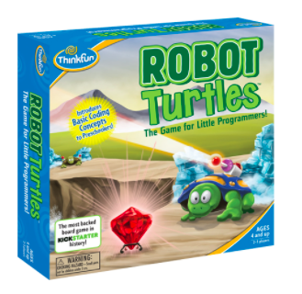
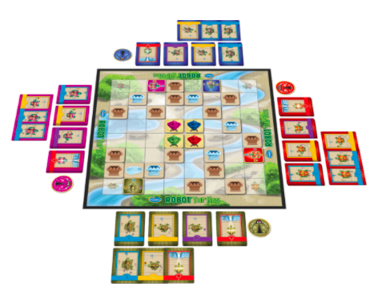
Programming
Let’s Try It!
You tell computers like the micro:bit what to do by giving them instructions. Sets of instructions for computers are called programs. Programs are written in code, a language that both you and the computer can understand.

Slide 9
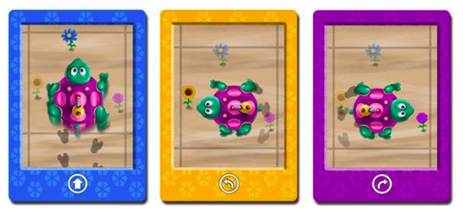
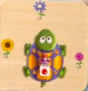
Functions in Robot Turtles
What do they do?
Notes:
Using grid paper, pick a point and use pencil to trace the path of the robot turtle, using this program. What did you make?

Slide 10
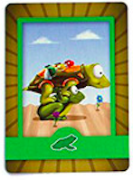
Functions in Robot Turtles
What do they do?
=
Notes:
How could we re-write the same program using fewer cards (or, less code)? Function frogs! Now try following the program again. Did you get the same shape? The first program had 11 cards, and this one has 5 ☺

Slide 11
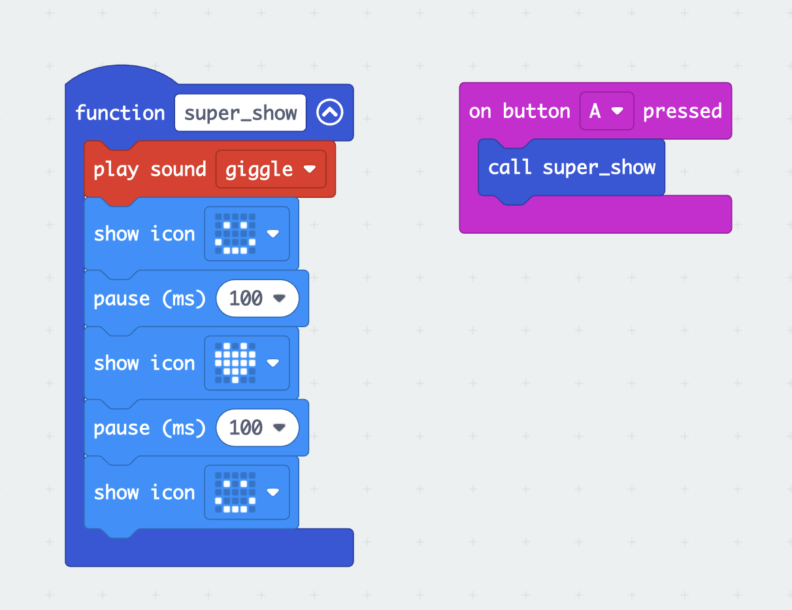
Functions in MakeCode
How do they work?
Select “Make a Function” from the “Functions” menu (under “Advanced”)
Give your function a name so you can “call” it later.
Click “Done”
Give your function some things to do!
Call your function after an action, like pressing a button.

Slide 12
Functions in MakeCode
Adding inputs to your function
Inputs
Program
(or function)
Output

Slide 13
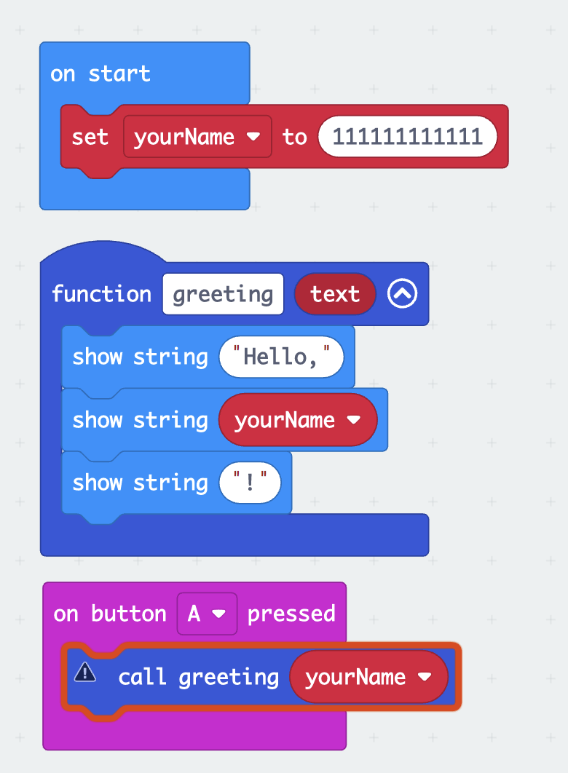
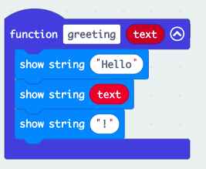
Functions in MakeCode
Adding inputs to your function
Sponge Bob

Slide 14
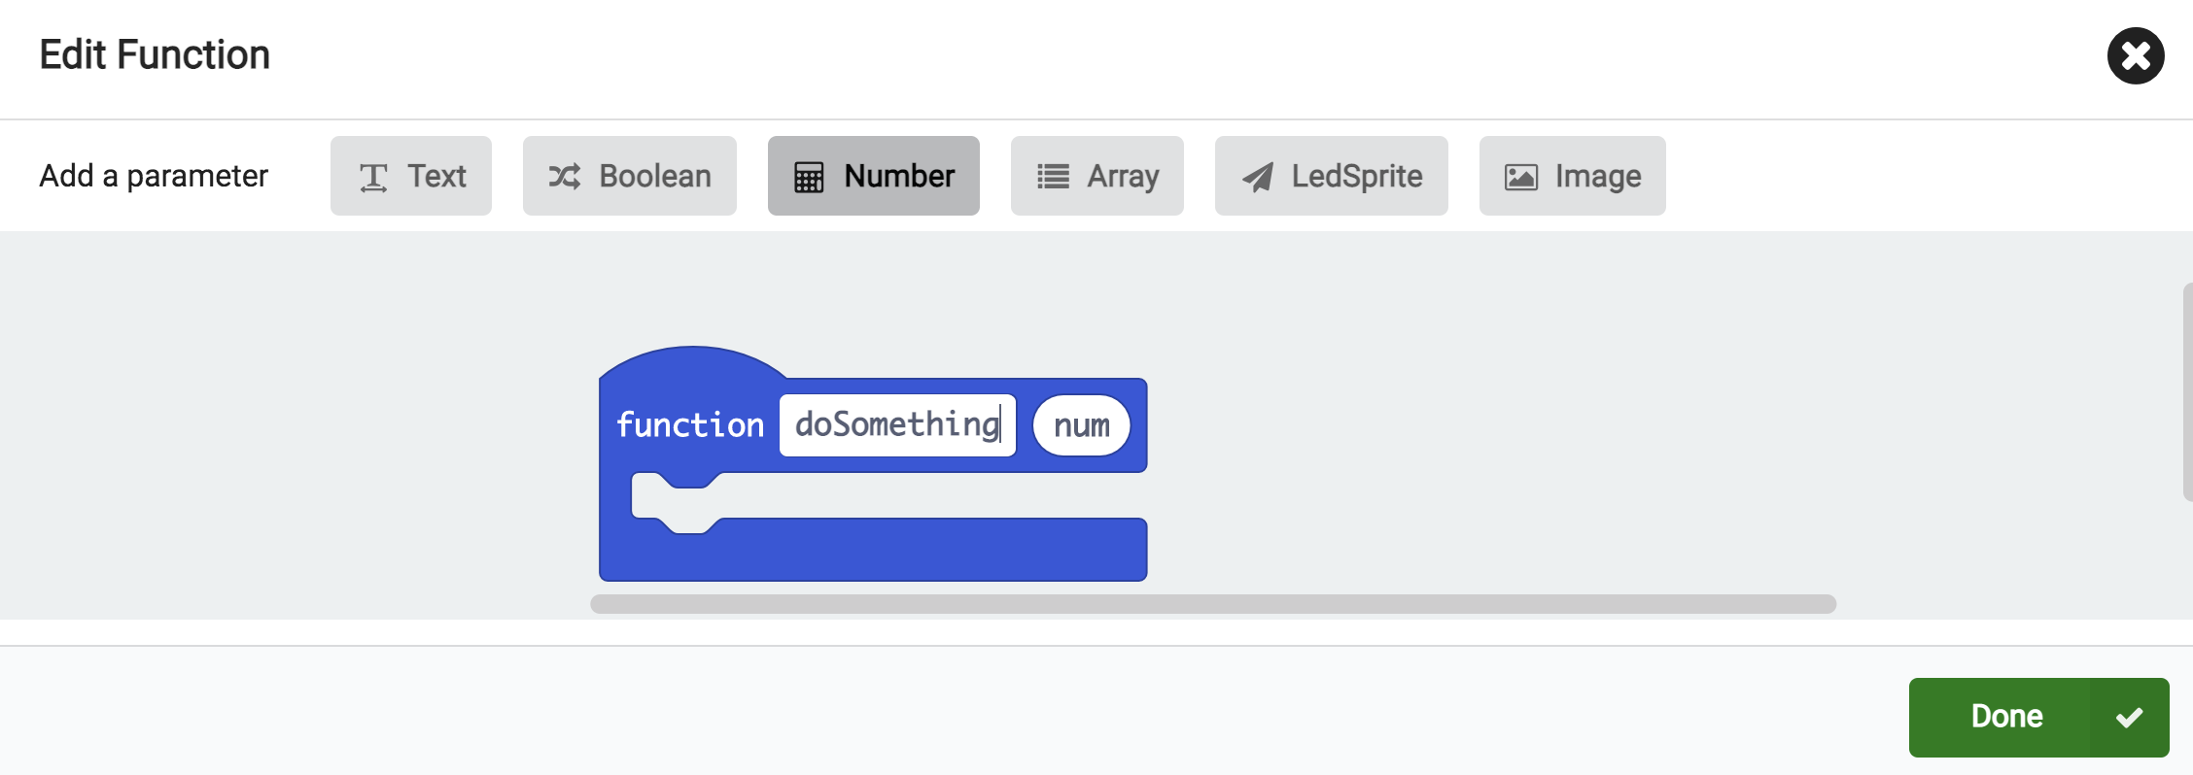
Functions in MakeCode
Adding inputs to your function.

Slide 15
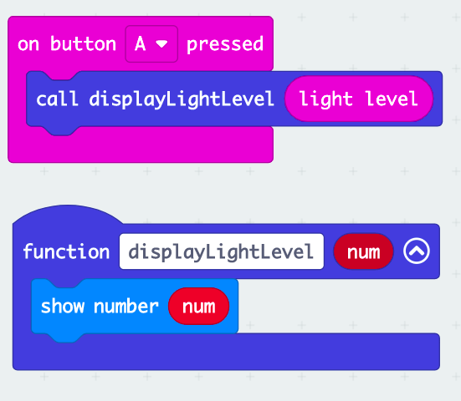




Functions in MakeCode
Turning inputs into outputs

Slide 16
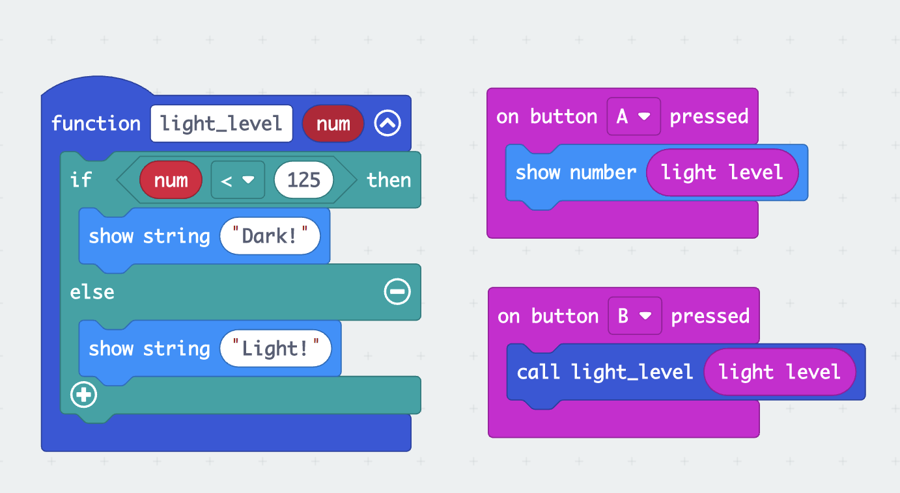
Functions in MakeCode
Practice!

Slide 17
Temperature
Let’s start making!

Slide 18


Slide 19
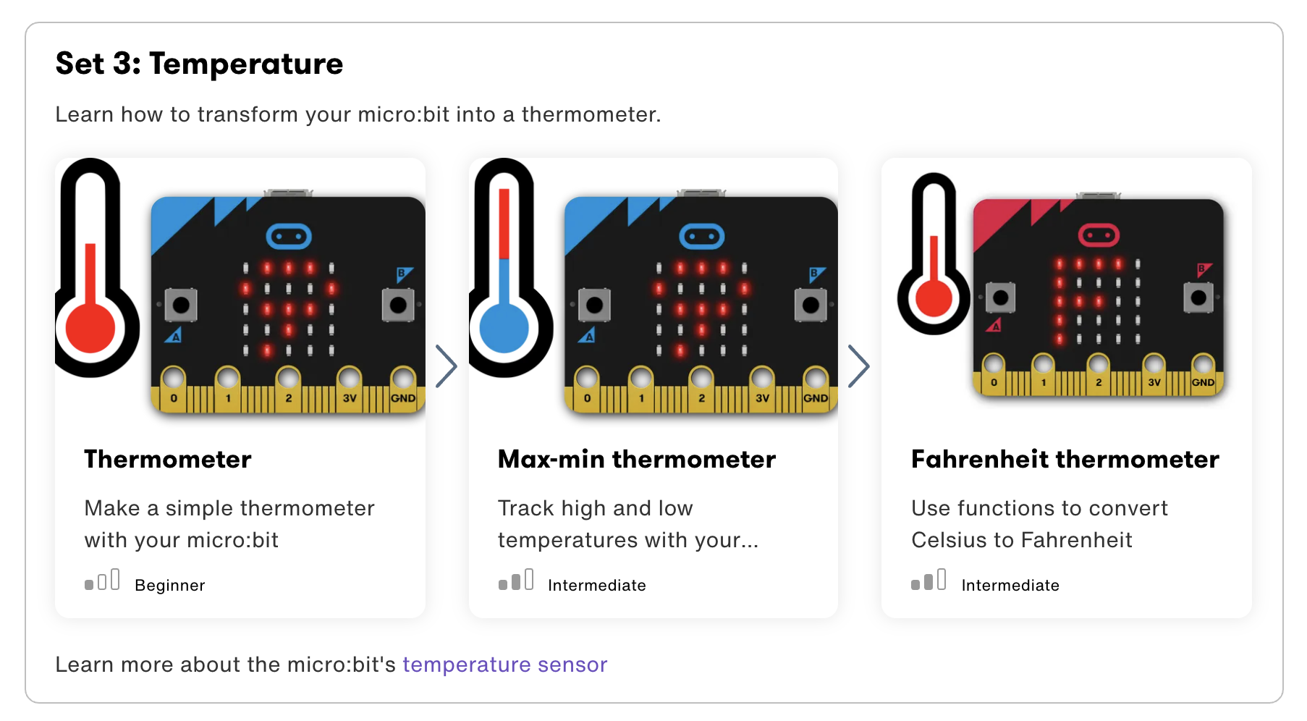

Slide 20
Step 1: The Project A Digital Thermometer
What is it?
Show how hot or cold your micro:bit is using the built-in temperature sensor
What do I need?
micro:bit (or MakeCode simulator) with USB
MakeCode or Python editor
Battery pack (optional)
A source of heat or cooling, like a fan, if you want to see the temperature change quickly (optional)

Slide 21
Step 2: How Does it Work?
How does it work?
This program shows how hot or cold your micro:bit is by taking a reading from the temperature sensor in its processor or CPU (central processing unit).
The processor’s temperature is a fairly good approximation of the temperature around you in °C (Celsius).
In this program, when you press input button A, the micro:bit displays the processor’s current temperature on its LED display output.
Take the micro:bit into warmer and colder places and see how the temperature readings change.

Slide 22
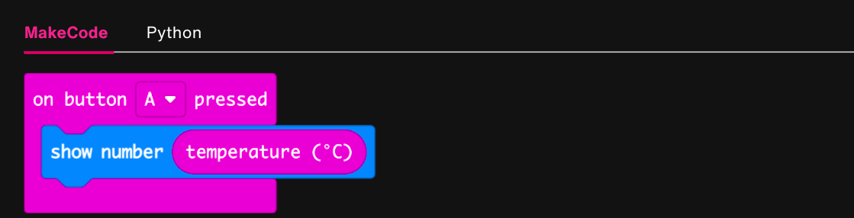
Step 3: Read It and Code It

Slide 23
Step 4: Share Your Creation!
Notes:
Do these temperatures seem right? C vs F.

Slide 24
Step 5: Improve It
Compare the reading with another thermometer. How accurate is the micro:bit? Do you need to modify the micro:bit reading to get the air temperature?
Convert the temperature to Fahrenheit or Kelvin.

Slide 25
Step 1: The Project Celsius to Fahrenheit Converter
What is it?
Use a simple function to convert centigrade readings from the micro:bit's temperature sensor to Fahrenheit.
What do I need?
micro:bit (or MakeCode simulator) with USB
MakeCode or Python editor
Battery pack (optional)

Slide 26
Step 2: How Does it Work?
How does it work?
The micro:bit's processor has a built-in temperature sensor input which gives readings in centigrade.
Using functions allows you easily to convert the temperature to Fahrenheit.
The convertCtoF function means you can re-use the conversion code easily for other programs.
The function is called by using convertCtoF in place of a variable or number when you press button B on your micro:bit.

Slide 27
Step 2: How Does it Work?
How does it work?
We pass to the function the temperature in centigrade.
The function then takes the number passed to it, stored in a variable called C, and converts it to Fahrenheit by multiplying it by 1.8 and adding 32.
The function then returns the converted number so when you press button B the temperature is shown in Fahrenheit on the LED display output.
If you press button A, the temperature is shown in centigrade.

Slide 28
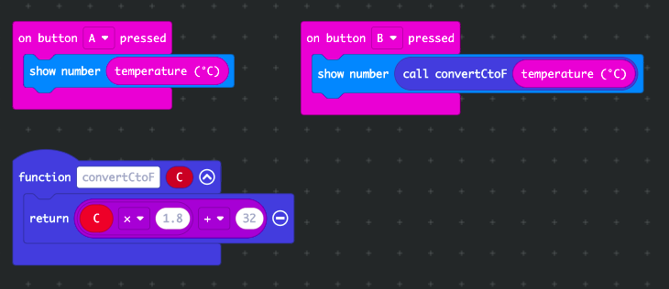
Functions!
Function Components
Name of the Function
Inputs
Processing Steps
Output
Notes:
From Robot Turtles, what is a function?

Slide 29
Step 3: Read It and Code It

Slide 30
Step 4: Share Your Creation!
Notes:
Use a fan to see how it changes the temperature.

Slide 31
Step 5: Improve It
Improve the display by showing 'C' or 'F' after the temperature in centigrade or Fahrenheit.
Advanced: Create your own function to add a conversion to degrees Kelvin when you press buttons A and B together.

Slide 32
BREAK!
20 jumping jacks please!

Slide 33

Step 1: The Project Micro:pet
What is it?
Make a cute digital pet that responds to different stimuli.
What do I need?
micro:bit (or MakeCode simulator) with USB
MakeCode or Python editor
Battery pack
A source of heat or cooling, like a fan, if you want to see the temperature change quickly.

Slide 34
Step 2: How Does it Work?
Now it is time to use everything you’ve learned so far about the micro:bit to create your pet! Your pet should do the following:
When you start your micro:bit, your pet should show a sleeping face.
When you pet your pet (touch the micro:bit logo touch sensor), your pet should smile and giggle. After pausing 5 seconds (5,000 miliseconds), they should go back to sleep.
When you shake your pet, your pet should frown and make a sad sound. After five seconds, they should go back to sleep.
When your pet gets too cold or too hot, they should frown and make a sad sound.
When you take your pet for a walk and go more than 20 steps, they should smile and giggle before falling back asleep.
Any other wonderful things you can think of!

Slide 35
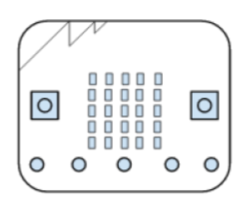
Step 3: (Pseudo) Code It!
When you start your micro:bit, your hamster should show a sleeping face.
On start
Show <sleeping face>

Slide 36
Step 3: (Pseudo) Code It!
When you pet your hamster (touch the micro:bit touch sensor), your pet should smile and giggle. After pausing 5 seconds (5,000 milliseconds), they should go back to sleep.
Input: When logo touched
Output:
Show <smile face>
Play <giggle sound>
Pause <5 seconds or 5,000 milliseconds>
Show <sleeping face>

Slide 37
Step 3: (Pseudo) Code It!
When your pet is upside down, your pet should frown and make a sad sound. After five seconds, they should go back to sleep.
Input: Is upside down
Output:
______________
______________
______________
______________

Slide 38
Step 3: (Pseudo) Code It!
When your hamster gets too cold or too hot, they should frown and make a sad sound.
Forever
Input: Temperature reading
Output:
If temperature greater than <a number>:
then show <sad face> and play <sad sound>
Else if temperature is less than <a number>:
then show <sad face> and play sad sound

Slide 39
Step 3: (Pseudo) Code It!
When you take your pet for a walk and go more than 20 steps, they should smile and giggle before falling back asleep.
On Start
Create variable “steps” and set to zero
Forever
Input: Accelerometer reading
Output:
If accelerometer reading is greater than <a number>:
then add one step to steps variable.
If steps variable is greater than 20:
Show <smile face>
Play <giggle sound>
Pause 5 seconds
Show <sleeping face>

Slide 40
Step 3: (Pseudo) Code It!
When your pet is in the dark, they get scared, and when they are in very, very bright light, they are surprised! What kinds of reactions might your pet make?
Forever
Input: _____________________
Output:
If ______________:
then ____________________
Else if ___________________:
then ____________________

Slide 41
Step 3: (Pseudo) Code It!
Before you start coding, plan out what you will do on paper, using the graph paper in your Lab Notes.
Use everything you’ve learned so far. Feel free to refer to old programs in your Lab Notes – that’s what real programmers do!

Slide 42
TIME TO PUT AWAY OUR MICRO:BITS!
Neat and tidy, please!
Let’s leave this beautiful room as lovely as we found it!

Slide 43
NEXT TIME
Finishing our Pets and Playing with Even More Sensors!!

Slide 44
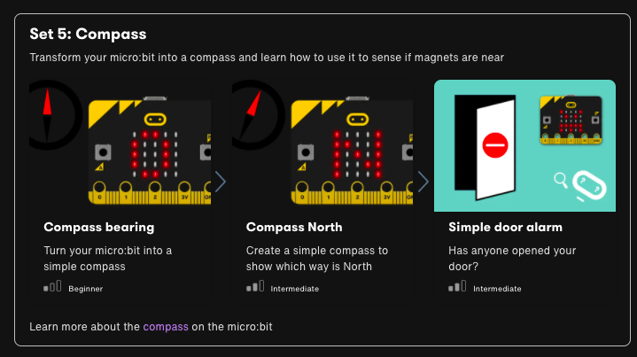

Slide 45

UNTIL NEXT TIME….
MicroMakers!
Slides and Script: Holly Krambeck (learningpython64@gmail.com)
Project Videos, Images, and Text: https://microbit.org/get-started

Slide 46
BONUS PROJECT
Advanced!

Slide 47
Step 1: The Project Max and Min Temperature
What is it?
Track highest and lowest temperatures by leaving this program running on a micro:bit.
What do I need?
micro:bit (or MakeCode simulator) with USB
MakeCode or Python editor
Battery pack (optional)
A source of heat or cooling, like a fan, if you want to see the temperature change quickly – or take the micro:bit outside
Graph paper if you want to keep a chart of temperatures over time

Slide 48
Max / Min Temperature Example
Tracking Weekly Max / Min Temperature
 | Average Temp | Week Max | Week Min
Day 1 | 75 | 75 | 75
Day 2 | 76 | 76 | 75
Day 3 | 80 | 80 | 75
Day 4 | 79 | 80 | 75
Day 5 | 70 | 80 | 70
Day 6 | 72 | 80 | 70
Day 7 | 82 | 82 | 70
Notes:
Walk through the code using this table.
For each day, – if temp is greater than max, set to max. If less than min, set to min.

Slide 49
Step 2: How Does it Work?
Like the Thermometer project, this uses the temperature sensor inside the micro:bit’s CPU (central processing unit) to measure the temperature in °C (Celsius).
This program keeps track of the lowest and highest temperatures recorded by using 3 variables: currentTemp is the current temperature reading, max is the maximum and min is the minimum.
At the start of the program they are all set to the same value; an infinite (forever) loop ensures that every two seconds it takes a reading, and the program compares the current temperature with the max and min variables.
If the current temperature is less than (<) than the value stored in the min variable, it changes the min variable to be the same as the current temperature.

Slide 50
Step 2: How Does it Work?
If the current temperature is greater than (>) the max variable’s value, it changes the max variable to be the same as the current temperature.
The program also flashes a dot on the LED display every time the infinite loop runs so that you know it’s working.
Press button A to show the minimum and button B to show the maximum temperatures recorded.
You could leave the micro:bit running for 24 hours, record the maximum and minimum temperatures and plot on a chart at the same time every day and then reset.

Slide 51
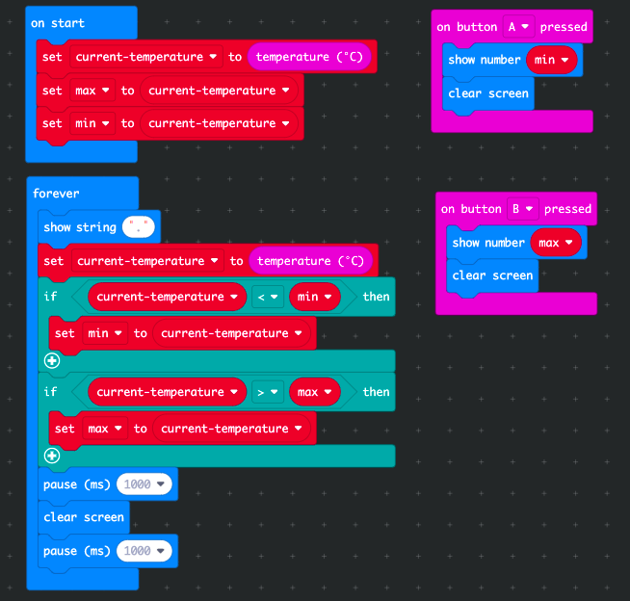
Step 3: Read It and Code It

Slide 52
Step 4: Share Your Creation!
Notes:
Do these temperatures seem right? C vs F.

Slide 53
Step 5: Improve It
Convert the temperature to Fahrenheit using another input, like two buttons or the accelerometer.

